Slide 1



Slide 2

Presiding
Gwendolyn J. Carroll, Chairman
Uplift Our Local Community (UOLC) Committee
Mu Upsilon Omega (MUO)
Greetings
Rev. Ron Rawls, Pastor
Greater Bethel A.M.E. Church
Ms. Stephanie Seawright, President
MUO Chapter

Slide 3
Invocation & Blessing of Food
Ms. Phyllis Hilliard
Chaplain - MUO Chapter
Occasion
Ms. Gwendolyn J. Carroll
Chairman, UOLC Committee
Introduction of Workshop Presenter
Ms. Evelyn Mickle
MUO/UOLC Committee

Slide 4
Presentation
Dr. Staja "Star" Booker, PhD, RN, FAAN
Dr. Staja “Star” Booker, PhD, RN, FAAN is a nurse of 15 years specializing in geriatric nursing. She hails from a small town in Louisiana, and graduated with a Bachelor of Science in Nursing from Grambling State University; a Master’s degree from Penn State University; and a PhD from The University of Iowa. Currently, she is a tenured Associate Professor at the University of Florida, College of Nursing. Dr. Booker is an influential leader, community servant, and active member of several national and international organizations which includes Delta Sigma Theta Sorority, Inc. Her motto is: Eat right, live right, be right!

Slide 5
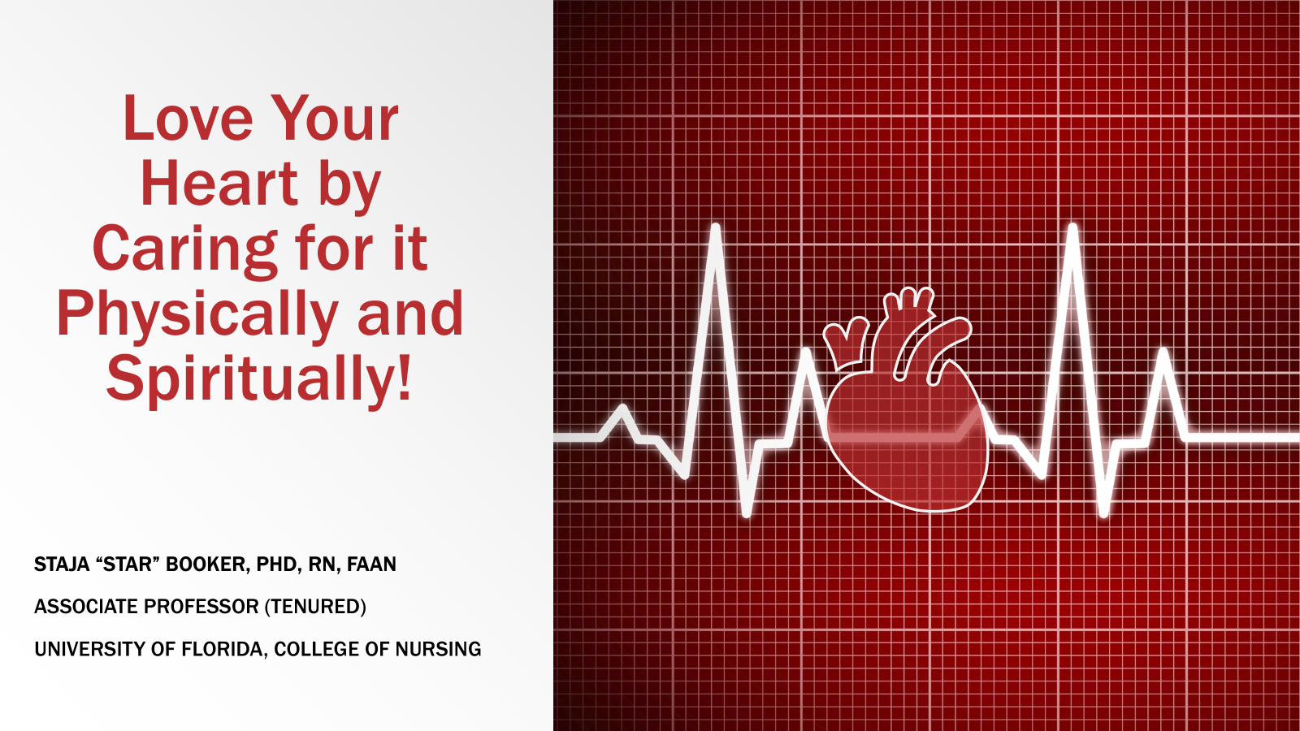

Slide 6

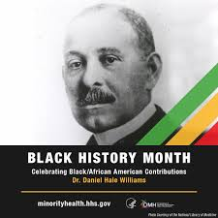
Happy Black History Month!
Dr. Daniel Hale Williams (1856–1931) is recognized as the first Black cardiologist and a pioneer in cardiac surgery.

Slide 7
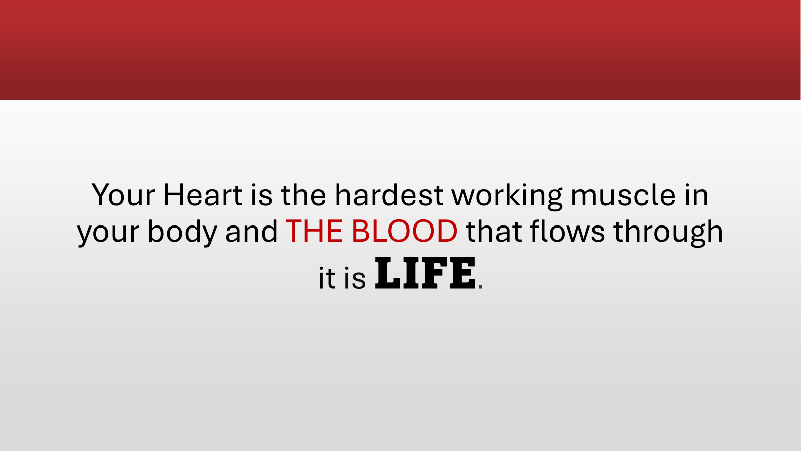

Slide 8
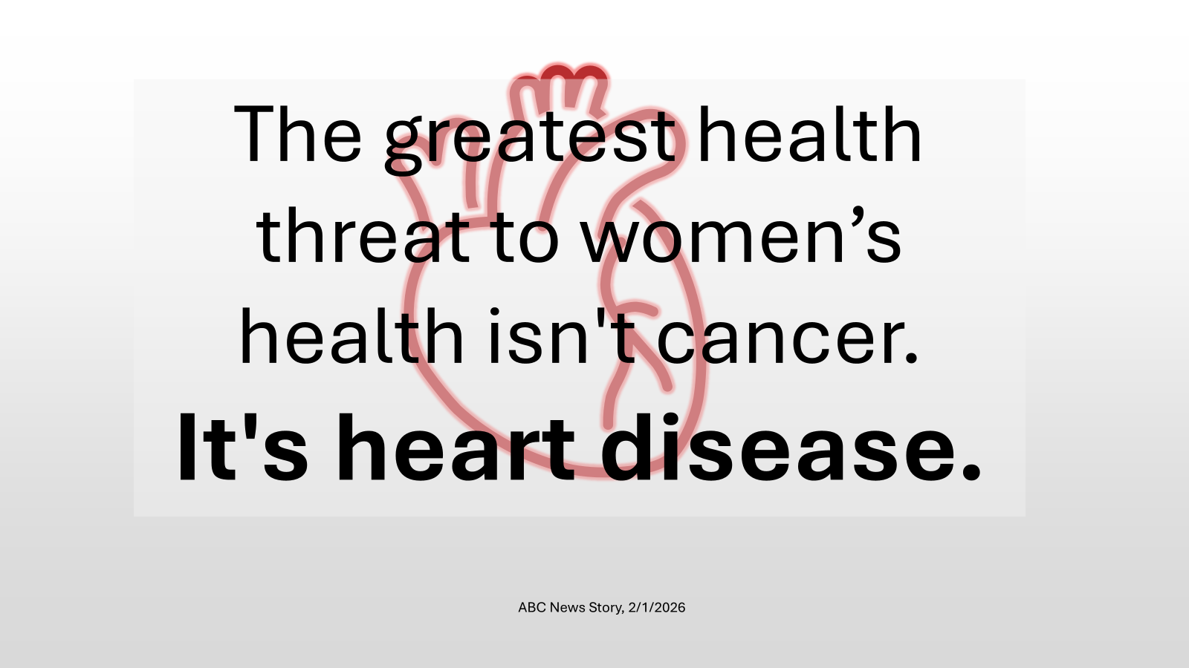

Slide 9
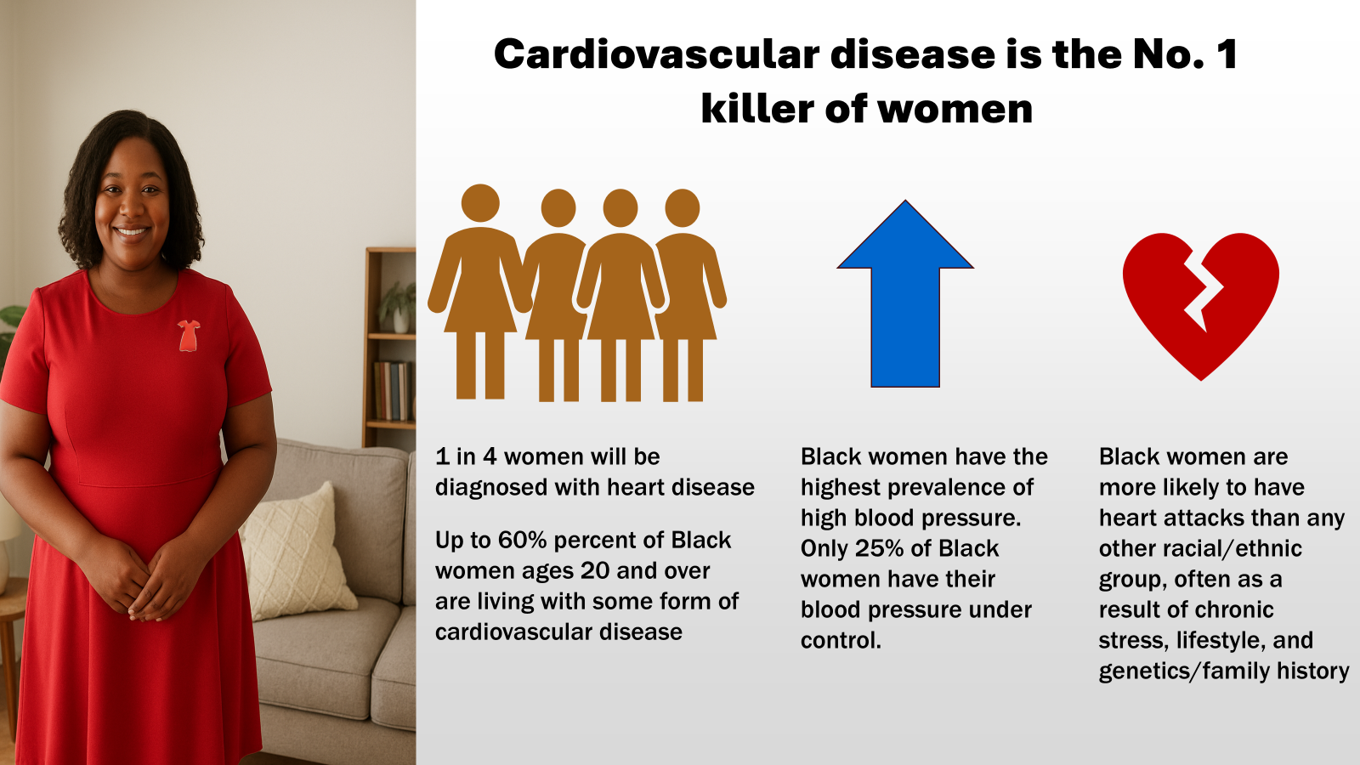

Slide 10
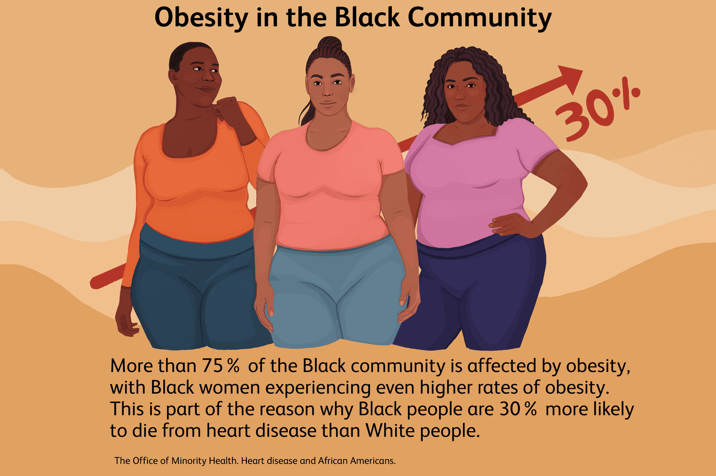
Obesity (BMI >30), which puts people at higher risk for cancer, heart disease and diabetes, now is deadlier than smoking. (Ho et al., 2021, BMC Public Health)
“Sitting is the new smoking”
Notes:
Normal BMI: 18.5-24.9

Slide 11
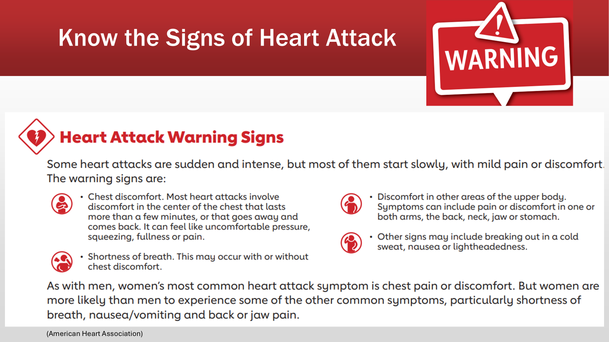

Slide 12
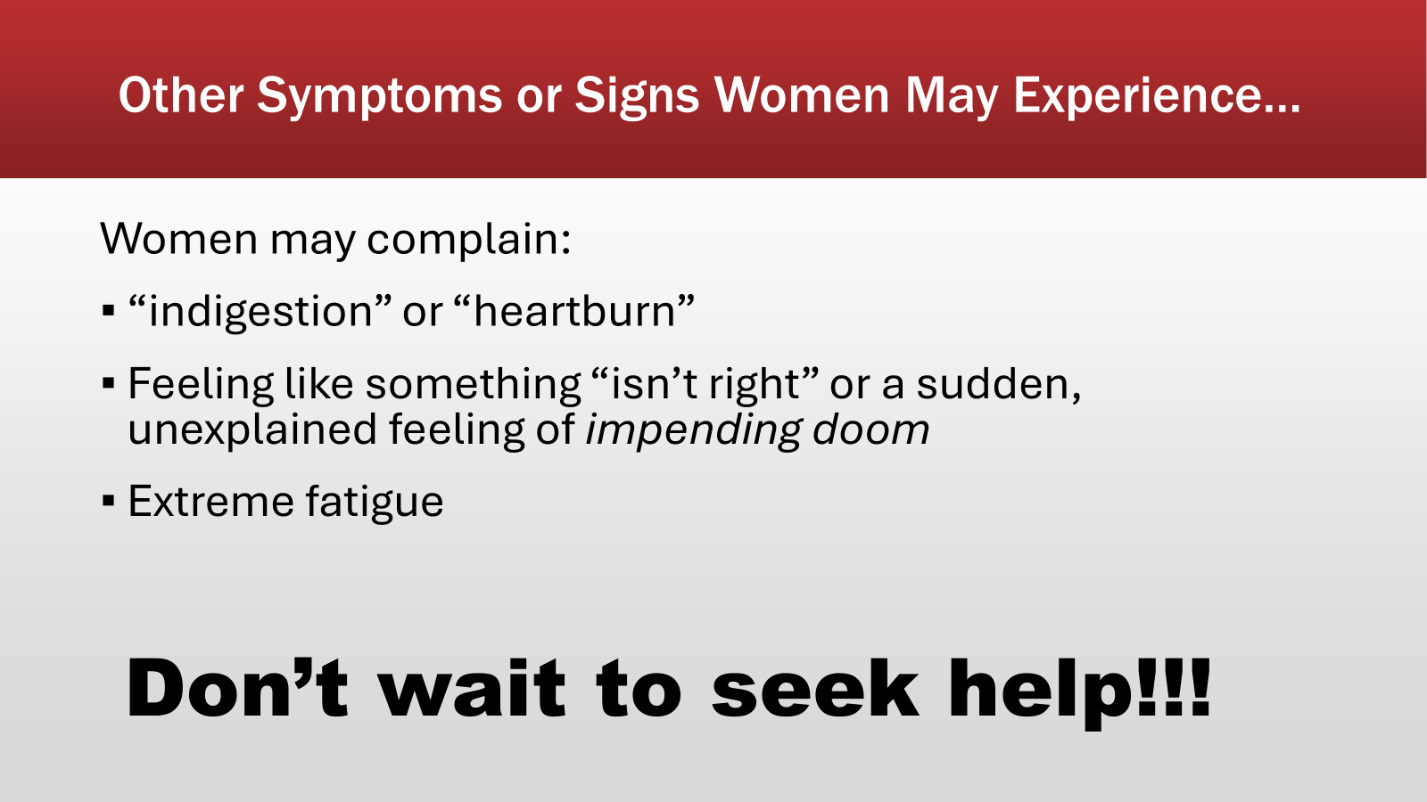

Slide 13
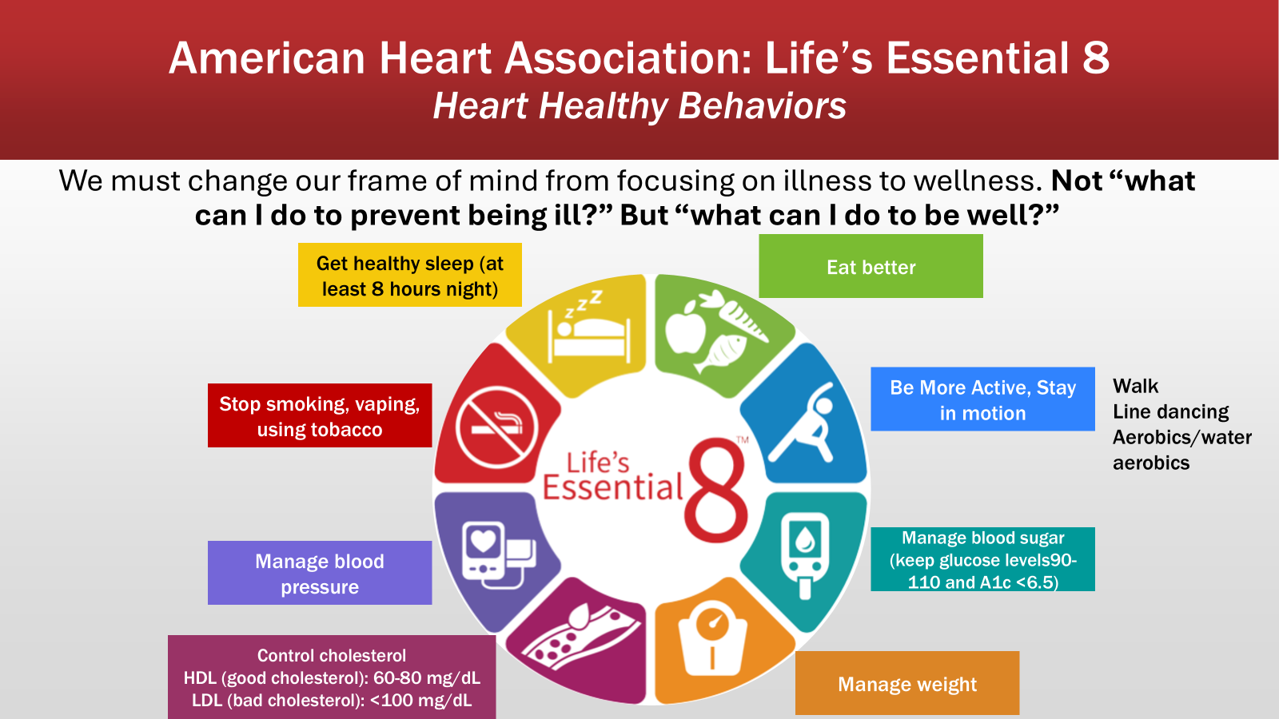

Slide 14
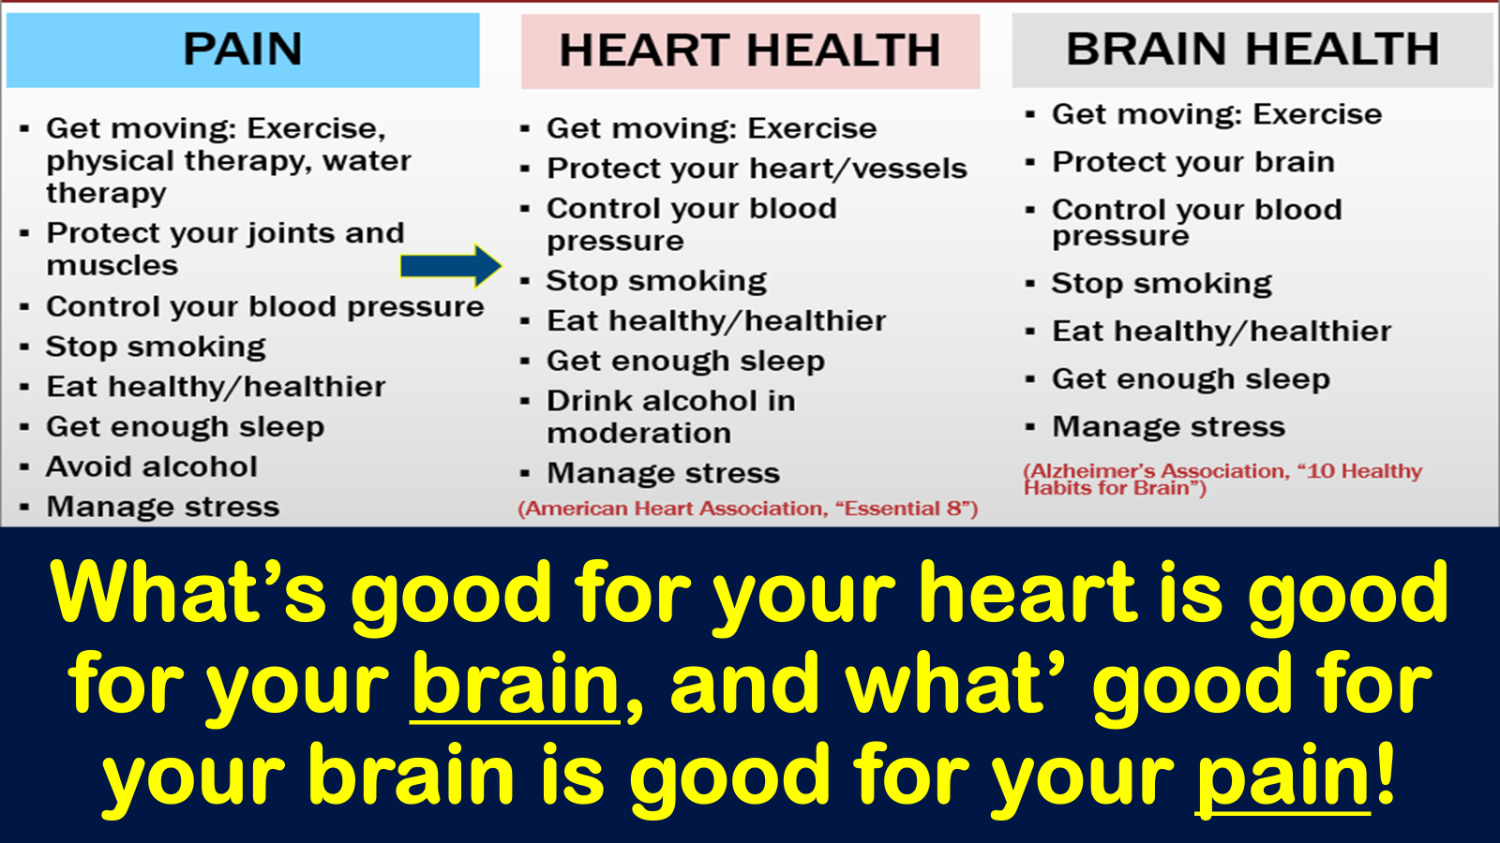

Slide 15
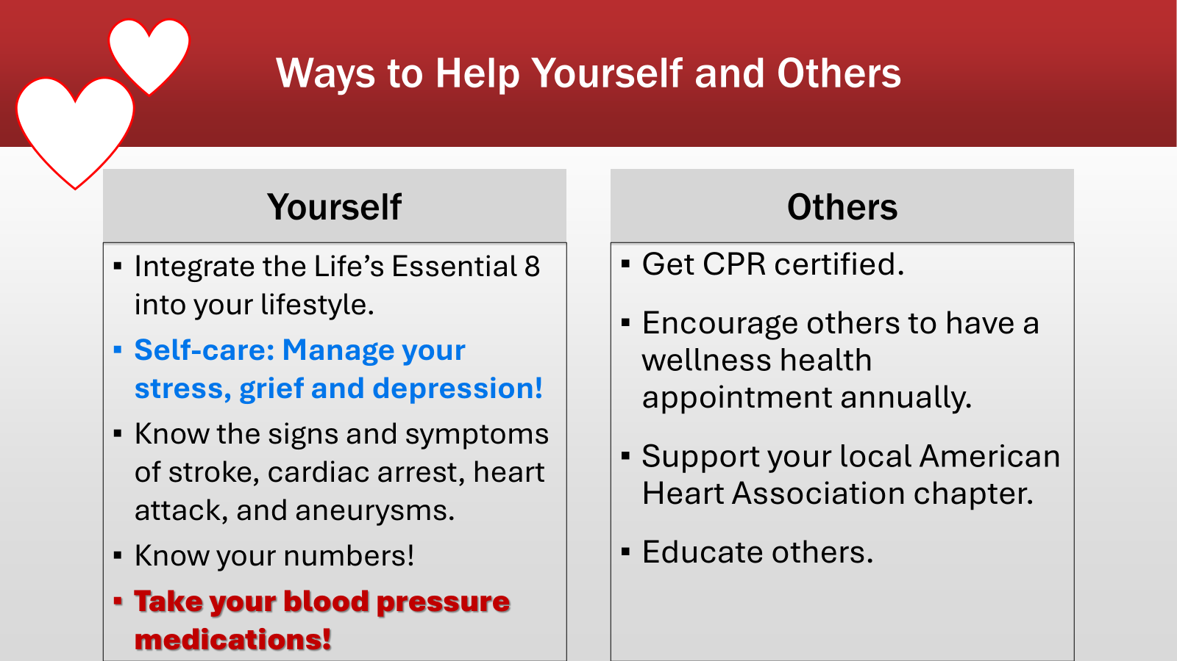

Slide 16
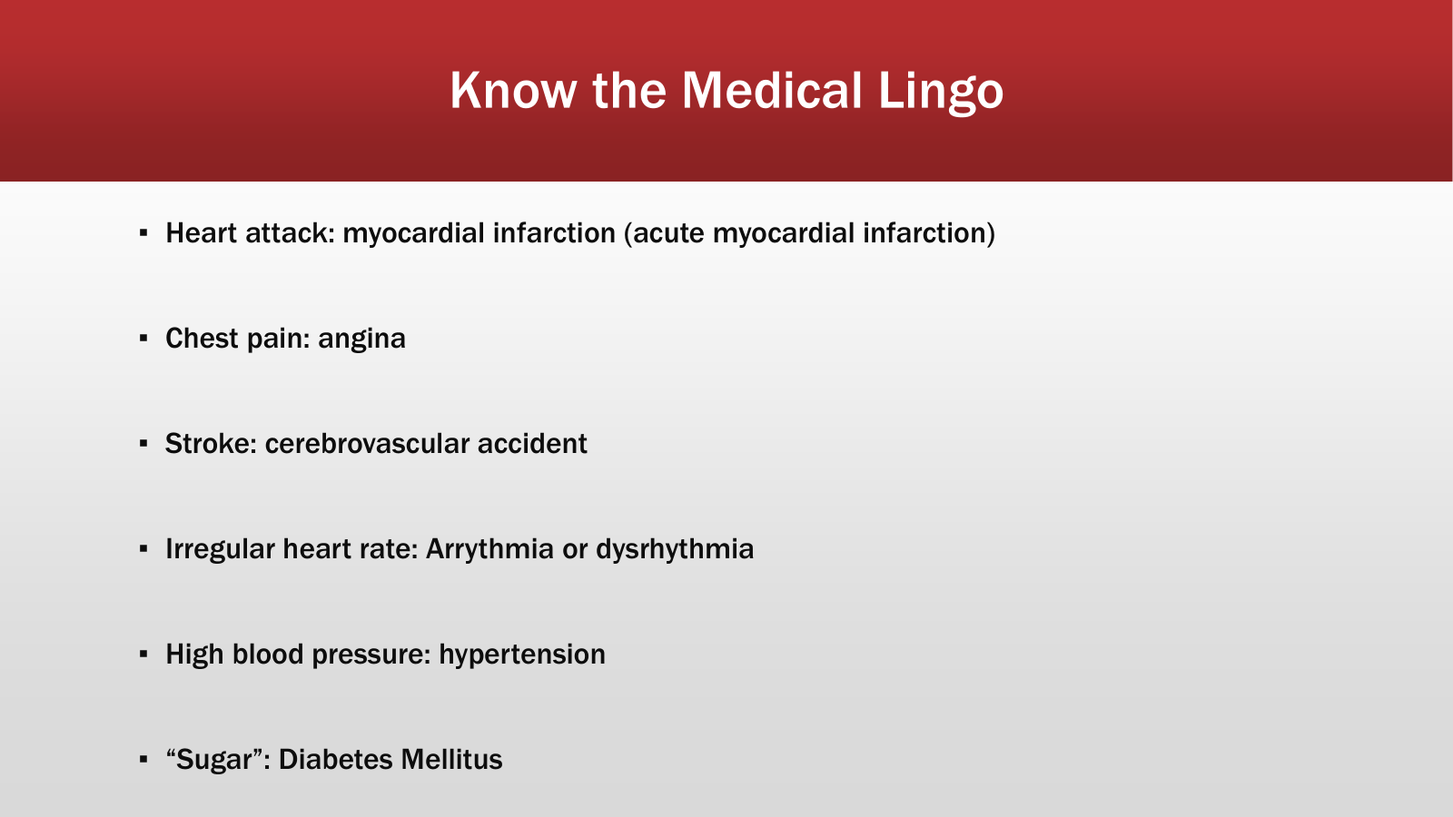

Slide 17
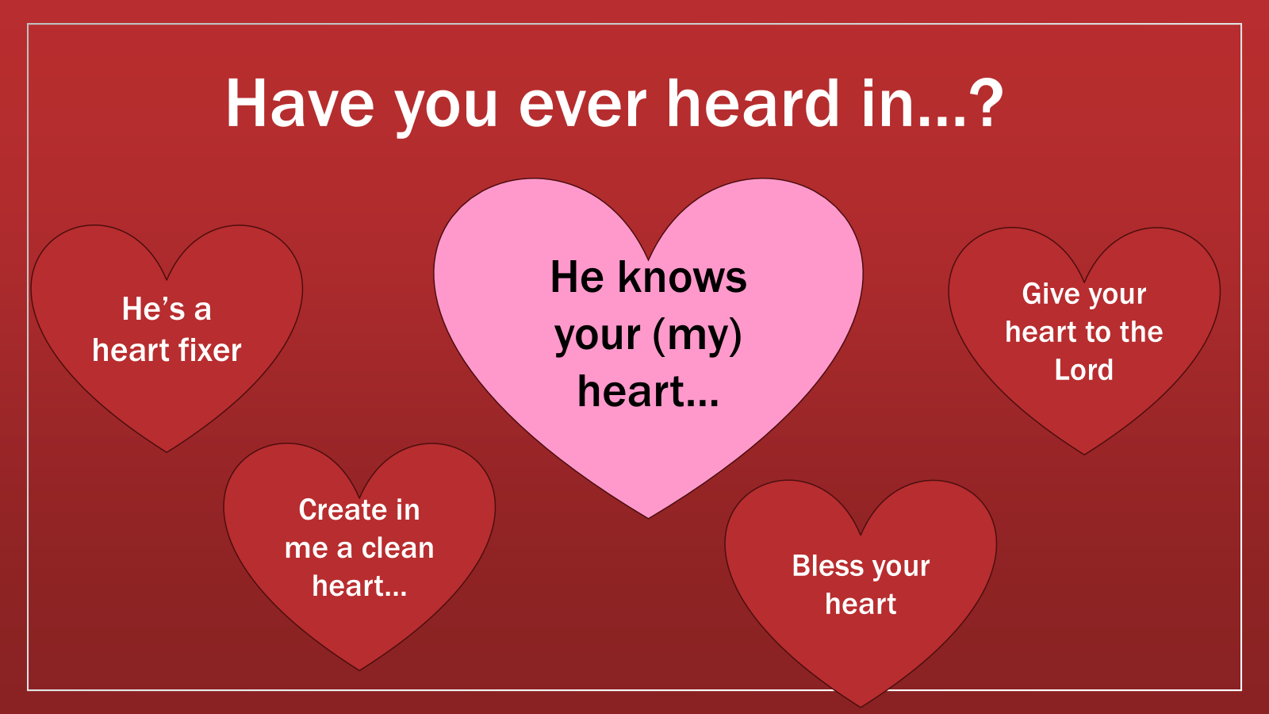

Slide 18
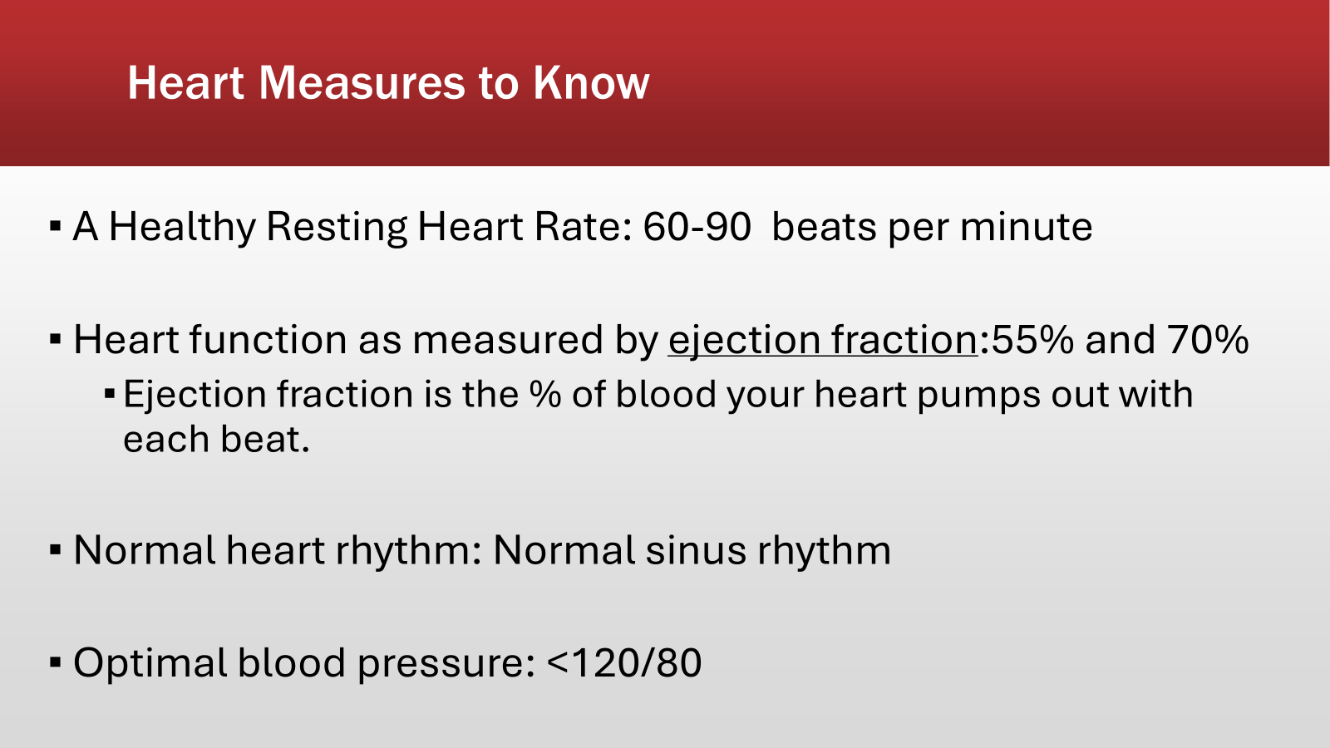

Slide 19
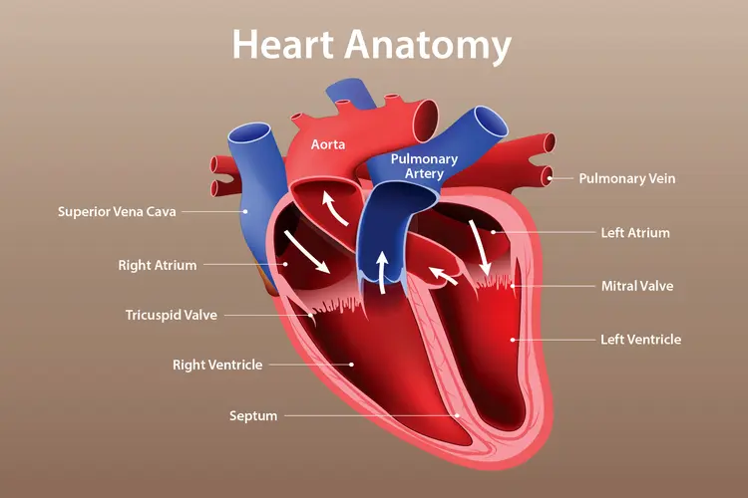
How to build and maintain a strong heart spiritually
Chambers of the heart
Valves
Blood vessels (coronary arteries and pulmonary vein)
Electrical System

Slide 20
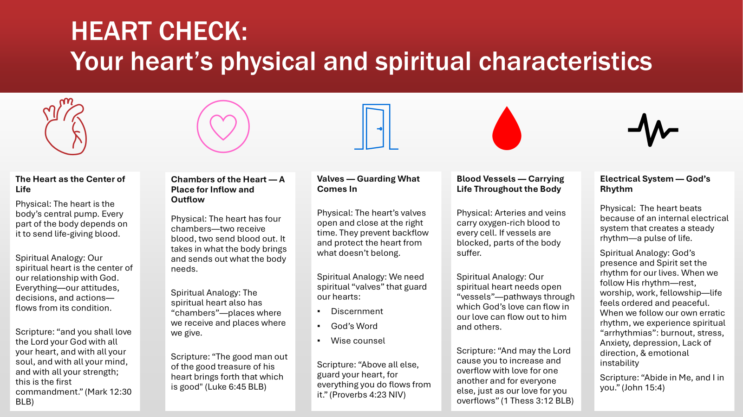

Slide 21
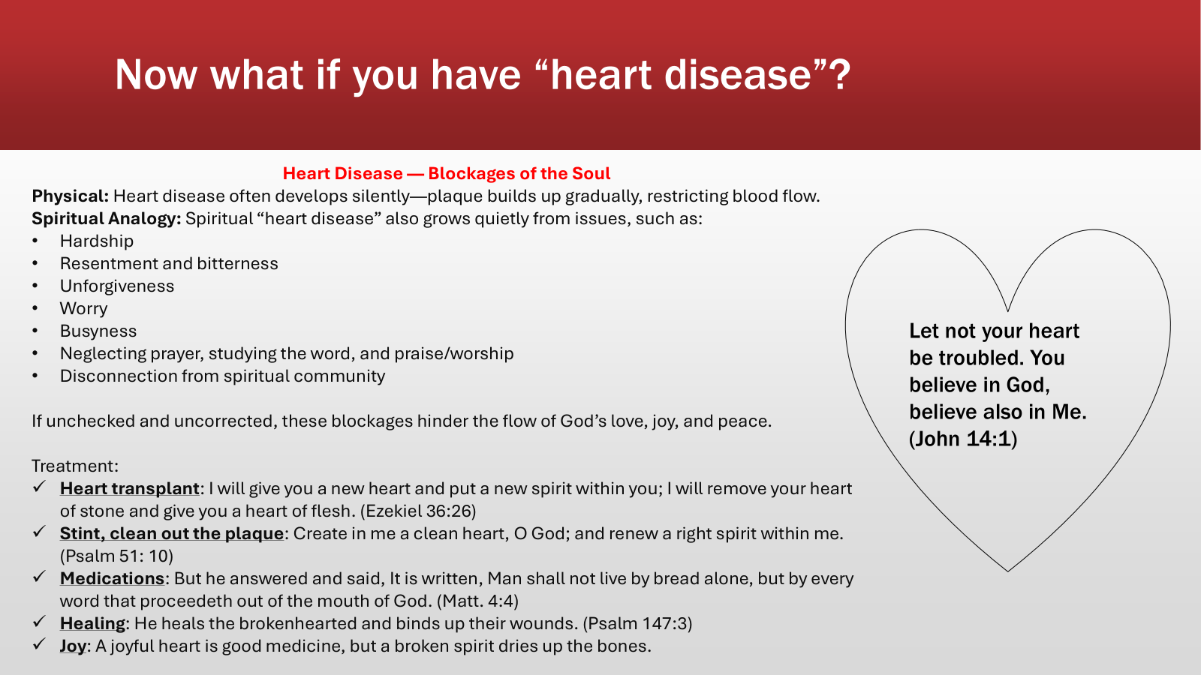

Slide 22
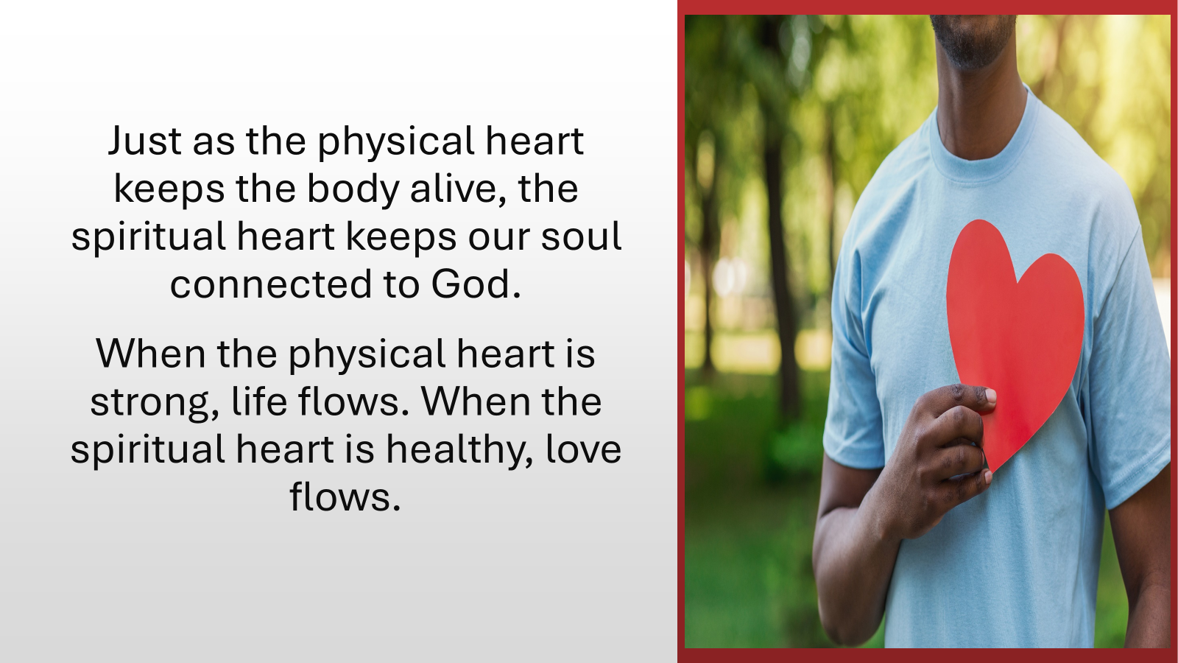

Slide 23
LOVE ON YOUR HEART!!!!
What you put into your body will keep you or kill you!
We must be very careful how we handle the things of God, including our health. Our bodies belong to God.

Slide 24
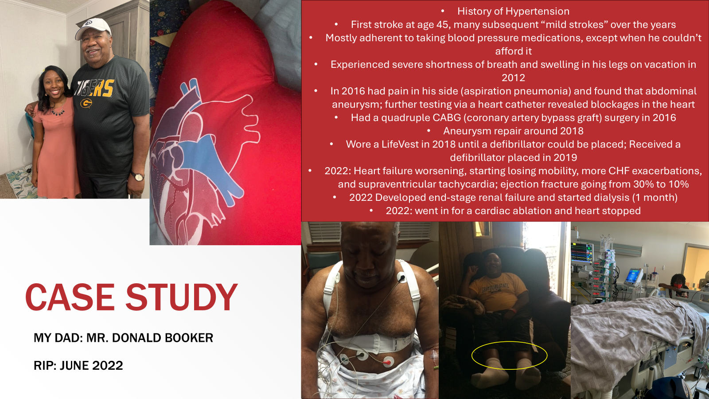

Slide 25
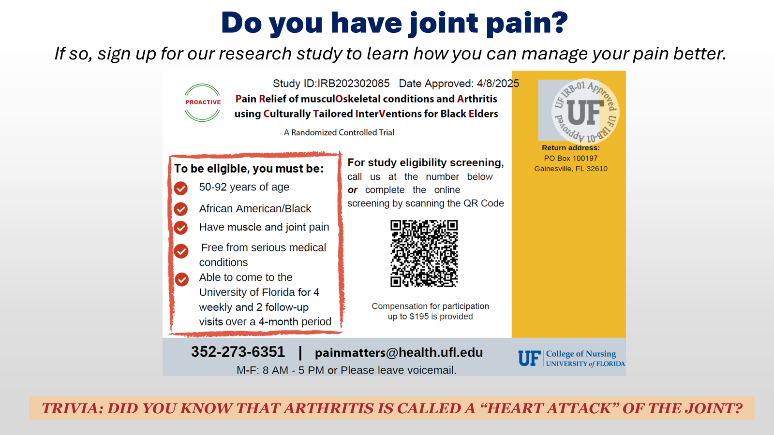

Slide 26
Introduction of Testimonial Guests
Judge Meshon Rawls, Coordinator of
Daughters of Sarah Women’s Ministry
Greater Bethel A.M.E. Church (GBAMEC)
*Rev. Larry Rogers - Member, GBAMEC
*Ms. Lavita Strickland - Member, GBAMEC

Slide 27
Q & A
Topics of Interest (Time Permitting):
“Common Heart Attack Warning Symptoms”
Dr. Judith Lightsey-Alford

Slide 28
Common Heart Attack Warning Symptons
  Chest pain or discomfort
  Pain or discomfort in the jaw, neck or back
  Pain or discomfort in the arms or shoulders
  Shortness of breath
  Feeling very tired lightheaded or faint
  Nausea or vomiting

Slide 29
Q & A
Topics of Interest (Time Permitting):
“A Guide to Common Heart Test”
Ms. Sarah Richardson

Slide 30
Common Heart Tests
Blood Pressure
Cholesterol, (LDL, HDL, Triglycerides, Total Blood Cholesterol)
Blood Glucose
Body Mass Index (BMI)

Slide 31
Door Prize & Cook Book Drawings
Ms. Faye McKnight
Ms. Shirley Green Brown
Closing Remarks
Dr. Judith Lightsey-Alford
UOLC Committee Co-Chairman
Dismissal
Lunch To Go- Fellowship Hall
Daughters of Sarah Women’s Ministry

Slide 32
ACKNOWLEDGEMENTS:
Rev. Ron Rawls, Pastor
Judge Meshon Rawls, GBAMEC &
UOLC Committee
The Daughters of Sarah Women’s Ministry and
Health Ministry of Greater Bethel A.M.E. Church
Dr. Staja "Star" Booker, PhD, RN, FAAN
Rev. Larry Rogers - Member, GBAMEC
Ms. Lavita Strickland - Member, GBAMEC

Slide 33
Ms. Stephanie Seawright, MUO Chapter President
Dr. Bridget S. Lee, Printed Program
Ms. Telisha Martin, Printed Certificates
Ms. Gwendolyn J. Carroll, Door Prizes
& Cook Books
Ms. C. Ann Scott, Donor

Slide 34
Sub-Committee Members:
Ms. Evelyn Mickle
Ms. Shirley Green Brown
Ms. Debbra Livingston
Dr. Judith Lightsey-Alford
Ms, Audrey Dukes
Ms. Faye McKnight
Ms. Sarah Richardson
Uplift Our Local Community Full Committee
& Mu Upsilon Omega Chapter

